Slide 1
JavaScript &
Functional Programming
CSC 330 Group Awesome

Slide 2
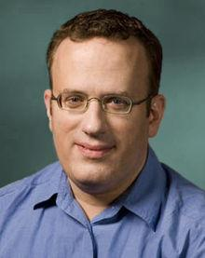
Javascript: Origins
Brendan Eich, 1995
“Bringing Scheme to the Browser”
Targeted towards amateur programmers
JScript, Microsoft Clone
Used in 89.3% of all websites, supported by all browsers
Brendan Eich
Notes:
Brendan Eich built JavaScript in 10 days; with a Scheme and Self like structure, but disguised with a Java-like syntax
First named Mocha, then LiveScript (6 months later), then JavaScript when Sun and Netscape started a license agreement
JavaScript would allow for simple animations and some intelligence in web forms
Browser Wars: Netscape (Mosaic → Netscape Navigator) vs. Microsoft (IE)
JavaScript was awesome and Microsoft decided to reverse engineer it to keep up in competition (JScript)
With only 10 days to build JavaScript, bugs were inevitable
JScript was a reverse engineering of JavaScript, and had accidently copied over its bugs too (lol)
Netscape was easily winning the browser wars up until about 1999
Ecma International took in JavaScript and standardized it

Slide 3

Functional Characteristics
First-class functions
Lexical Scoping
Global variables can be declared implicitly at the global level
Closures
jQuery utilizes JavaScript’s functional characteristics
Notes:
jQuery is an example of a well-known and widely used library that effectively utilizes JavaScript’s functional programming features. The root jQuery object that you call in the library can be qualified as a monad, a structure that represents computations defined as sequences of steps. A monad is a fundamental concept of functional programming languages.

Slide 4


JavaScript Expressiveness
Readable
Built with the web designer in mind
Compact
Popular libraries like jQuery offer solutions to common problems
$.animate, $.ajax, $.clone
Powerful
Client Side / Server Side
HTML5 features extending the JavaScript API
Canvas, WebGL, Media Queries, Geolocation, FileBlobs
Notes:
server side - node.js, can run JavaScript on both server and client sides.
Canvas - drawing WebGL - working with Canvas, OpenGL stuff
Media Queries - microphone/webcam
Geolocation - maps, locate user’s position (YOU ARE HERE)
FileBlobs - writing files on client side to be able to download, create files on the fly

Slide 5

Lazy JavaScript
function(){return my_delayed_function()}
efficient mapping / filtering
indefinite sequences
parsing strings
Node-Lazy

Slide 6
Efficient Mapping / Filtering
With Lazy.js | Without Lazy.js
var result = Lazy(array) .map(myfunction) .filter(myfilter) .take(somenumber); | var results = []; for (var i = 0; i < array.length; ++i) { var value = myfunction(array[i]); if (!myfilter(value)) { results.push(value); if (results.length === somenumber) { break; } } }
var result = _.chain(array).map(myfunction).filter(myfilter).take(somenumber).value();
generates several arrays

Slide 7
Indefinite Sequences
var unlimitedRandomNumbers = Lazy.generate(function() { return Math.random(); }) .map(function(e) { return Math.floor(e * 1000) + 1; }) .take(somenumber);

Slide 8
String Parsing
var firstFiveLines = Lazy(text).split("\n").take(5);
No need to parse entire string

Slide 9
Node-Lazy
With Node-Lazy | Without
var Store = require('supermarket'); var db = new Store({ filename : 'users.db', json : true }); db.filter(function (user, meta) { return meta.age > 20; }) .take(5) .join(function (xs) { // xs contains the first 5 users who are over 20! }); | var Store = require('supermarket'); var db = new Store({ filename : 'users.db', json : true }); var users_over_20 = []; db.filter( function (user, meta) { // predicate function return meta.age > 20; }, function (err, user, meta) { // function that gets executed when predicate is true if (users_over_20.length < 5) users_over_20.push(meta); }, function () { // done function, called when all records have been filtered // now do something with users_over_20 } )

Slide 10

Closure - What is closure?
Developed in the 1960s as a feature of Scheme as a method for supporting lexically scoped first-class functions
Defined to include two things: a function and an environment, which consists of any local variables that were in scope at the time that the closure was created.
These variables can be referenced by the function even after their scope has terminated.
𝛌𝚡.𝚡𝚢 => 𝛌𝚢.(𝛌𝚡.𝚡𝚢)
Notes:
example of lambda expression for a closure - closure created (ly) such that otherwise free variable y is bound.

Slide 11
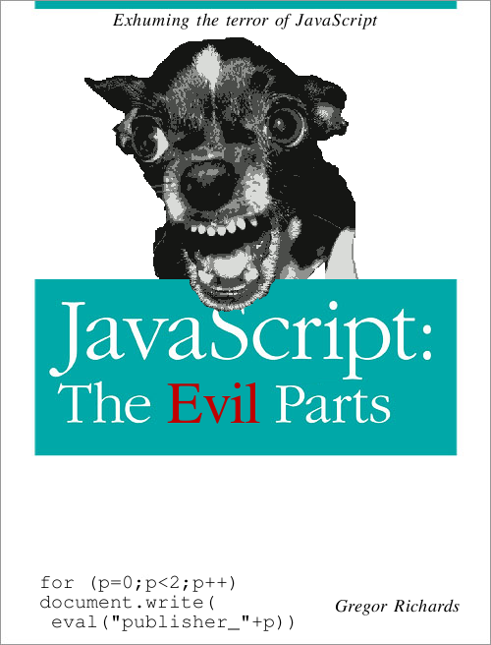
Closure - How JavaScript implements closure
Closures are used extensively throughout JavaScript and can be created in one of two ways:
By returning a function that was defined within a called function
By creating an anonymous function and assigning it to a variable
When the closure is called, JavaScript uses the scope bound to the closure to resolve non-local variables referenced within the function.
Two problems with JavaScript’s implementation of closures: this keyword & global scoping
Notes:
problem 1: In JavaScript, and many other object oriented languages, the this variable is used to point to the current context the function is executing in. In normal functions, this refers to the global context (JavaScript stores this as the Window object); however, when inside a method of an object, this refers to the instance of the object the method is being called on. The problem arises when a closure is created inside a method of an object. In this case, the this variable is not stored as part of the scope bound to the closure, so inside a closure, this always refers to the global Window object.
problem 2: handling of global variables referenced from within the closure. By definition, a closure is supposed to be self-contained, it should be free of any dependency on the environment in which the closure is executed. If a closure in JavaScript references a global variable, the self-contained aspect of the closure breaks down. In JavaScript, the global scope is not stored as part of the scope bound to the closure, so when the global variable is referenced the value depends on the current global scope.

Slide 12

Higher Order Functions in JavaScript
higher order functions refer to functions which take a function as a parameter and return a function as a return value
JavaScript Map function:
array.map(callback[, thisArg])
--------------------------------------
Parameters:
callback: function that produces an element
of the new Array from an element of the current one.
thisArg: object to use as this keyword when executing
callback (optional argument).
example of Map function in JavaScript

Slide 13

List Comprehension
Predicates and generators:
JavaScript supports predicates in the form of ‘guard functions’
Guard functions work almost identically to predicates, outputs True or False
Haskell Example: [x | x <- [0,1,2,3,4,5], x > 3], Outputs: [4,5]
JavaScript Example: [x for each (x in [0,1,2,3,4,5]) if x > 3], Outputs: [4,5]

Slide 14

List Comprehension
Although Haskell supports generators in list comprehension J.S does NOT support it in array comprehension
Arrays must be defined and finite before array comprehension can use them to construct a new array
Haskell can have dependent multiple, and variable, generators:
[(x,y) | x <- [1..3], y <- [x..3]] O.P [(1,1),(1,2),(1,3),(2,2),(2,3),(3,3)]
[x | x <- [1..n], n’mod’x == 0] Will output factors of user input ‘n’

Slide 15
List Comprehension
Style and Expressiveness:
Haskell uses the set-comprehension notation:
Haskell: s = [x | x <- [0..5], x > 2]
JavaScript approximates set-comprehension notation but without generators:
JavaScript: js> [x for each (x in [0,1,2,3,4,5]) if x > 2]
Haskell's list comprehension style is more expressive than JavaScript:
A JavaScript sometimes requires more lines and User Defined Functions compared to an equivalent Haskell statement.
Javascript cannot represent the same breadth of ideas as Haskell due to lack of generator support

Slide 16
Questions?

